Slide 1
Big Mountain Resort
By Nan Zhou
Feb 3, 2021

Slide 2
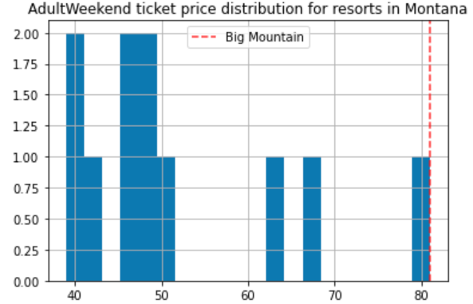
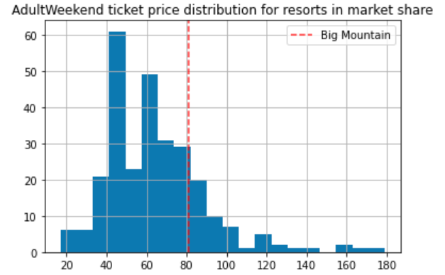
What is the problem?
$1,540K additional operating cost per season
$81 ticket price
Notes:
350,000 visitors per season, 5 tickets per visitor on average

Slide 3
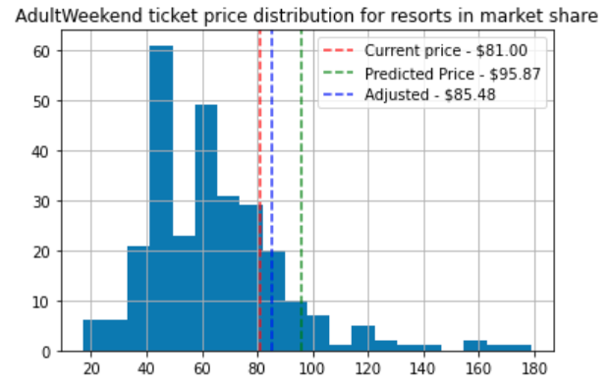
One solution
Raise $1 ticket price to $82
Increase revenue $1,750K
= 350,000 visitors *
5 tickets per visitor on average
Notes:
Big mountain’s facilities and properties supported predicted price $95.87, with mean absolute error $10.39

Slide 4
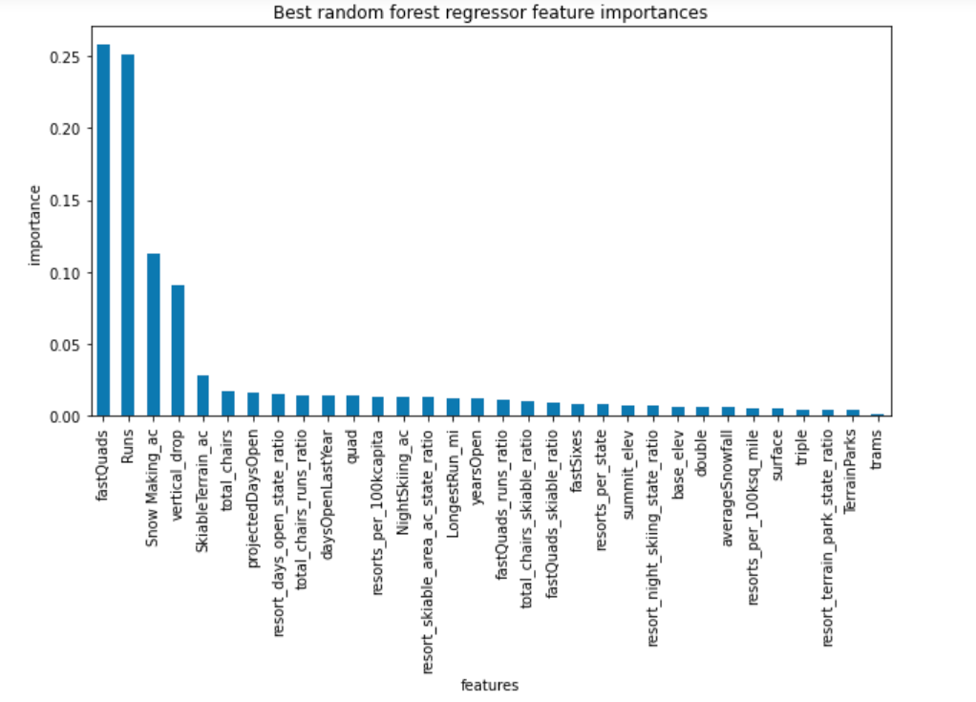
Most important features

Slide 5
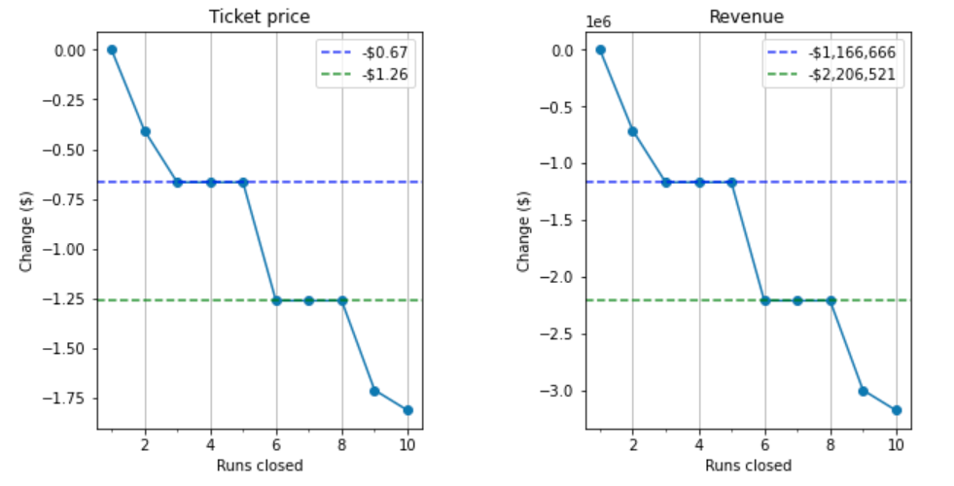
Other Options -1
Closing 5 or 8 runs

Slide 6
Other Options – 2 and 3
2
Runs: 1
Vertical drop: 150 feet
3
Runs: 1
Snow making: 2 acres
Total chair: 1
Vertical drop: 150 feet
Total chair: 1
Ticket price increase : $1.99
Revenue increase : $3,474,638
Investment and extra operation cost: ?
Notes:
Based on the model, the New features support for price increase

Slide 7
Other Options - 4
Increase the longest run by 0.2 miles
$0

Slide 8
Conclusion & Dependency
Consumer analysis: local visitor vs out-of-statue visitor?
One time investment on option 2 and 3
Additional operation cost per season on option 2 and 3

